Slide 1
An Introduction to
Federated Learning
RAJESH KUMAR

Slide 2
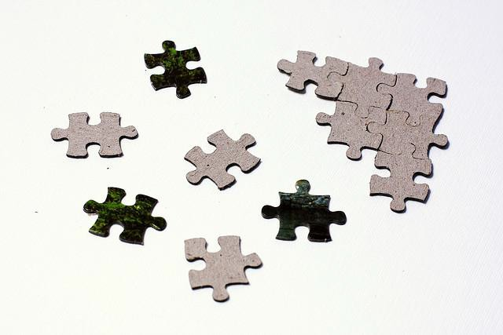
Challenge for AI : Data Fragmentation, Data Silos
2

Slide 3
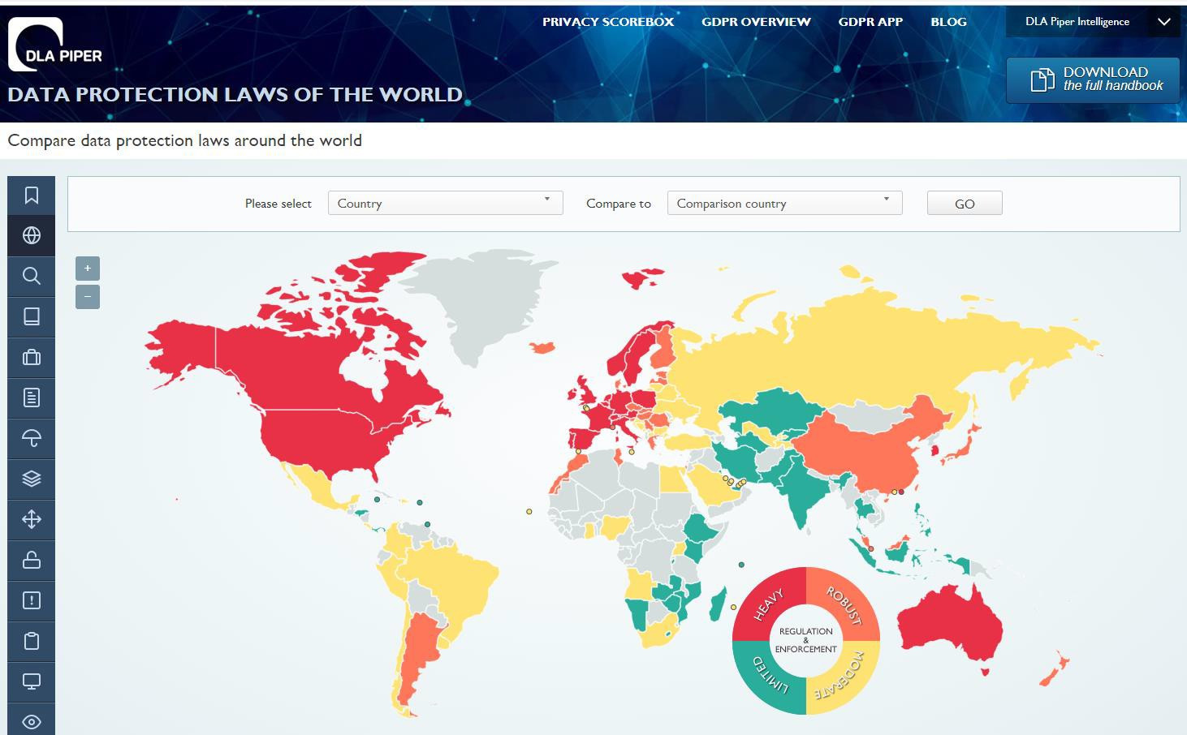
Background
DLA Piper
Increasingly strict laws on
data protection:
GDPR of EU, 2018
CCPA of USA, 2018
Cyber Security Law of China, 2017
Growing concern on user privacy and data security
Data exist in the form of isolated silos.
Federated learning can be a solution! [McMahan’16, Yang’19]
Reference：
[1] DLA Piper, Data Protection Laws of the World https://www.dlapiperdataprotection.c om/
[2] DLA Piper, Data Protection Laws of the World, Full Handbook
Image from DLA Piper
3

Slide 4


Data Sharing Among Parties: Difficult, Impossible, Illegal
Medical clinical trial data cannot be shared (by R. Stegeman 2018
Our society demands more control on data privacy and security
on Genemetics)
GDPR, Government Regulations
Corporate Security and Confidentiality Concerns
Data privacy concerns

Slide 5
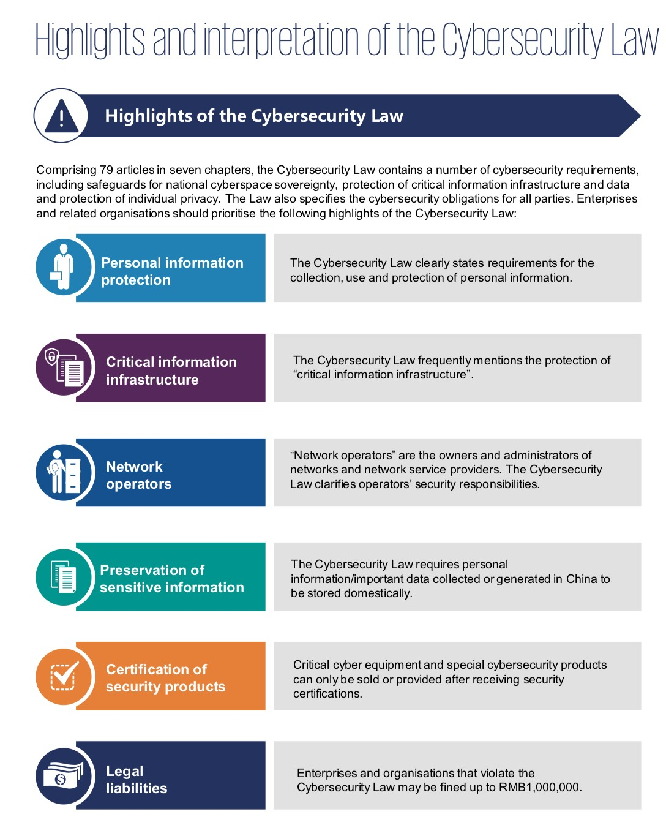
China’s Data Privacy Laws
Many enacted since 2017
Requires that Internet businesses must not
leak or tamper with the personal information
When conducting data transactions with third parties, they need to ensure that the proposed contract follow legal data protection obligations.
More to come…
From Report by KPMG 2017

Slide 6



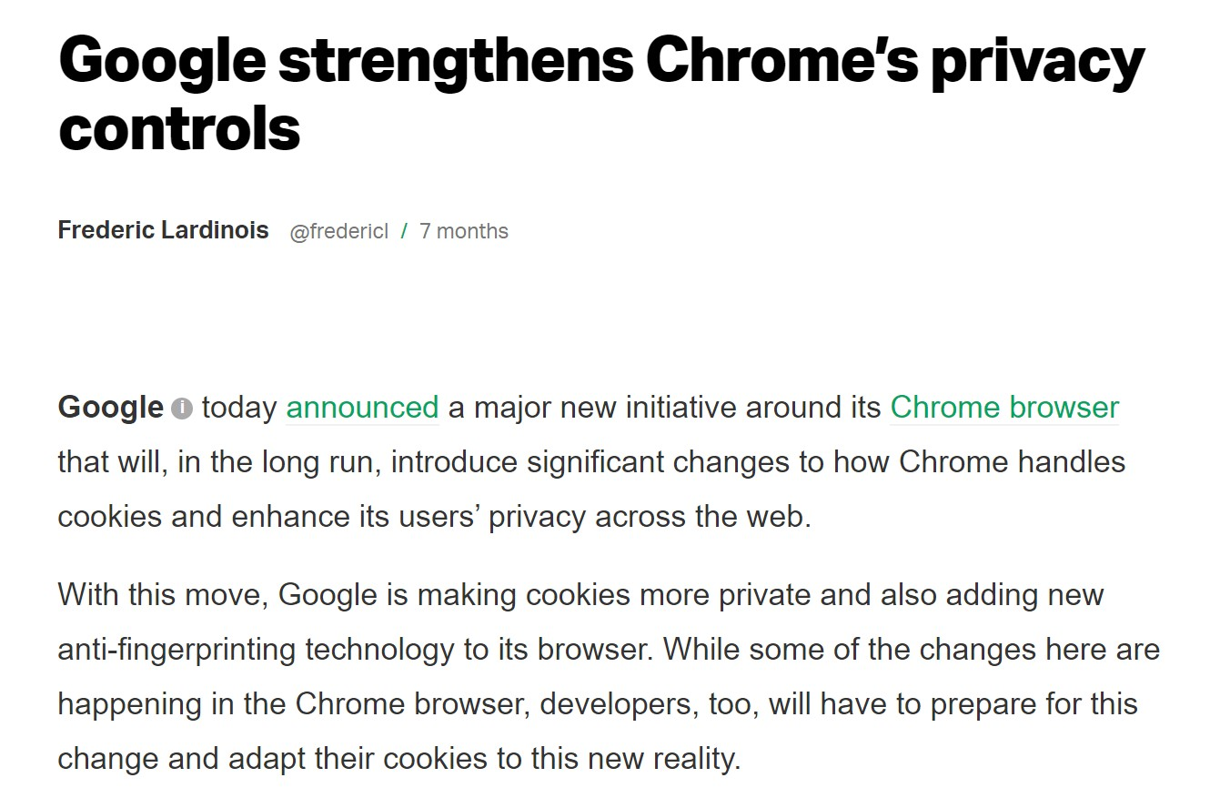

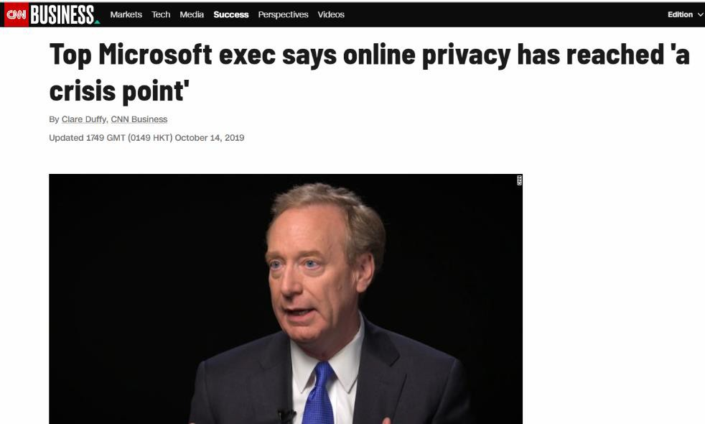

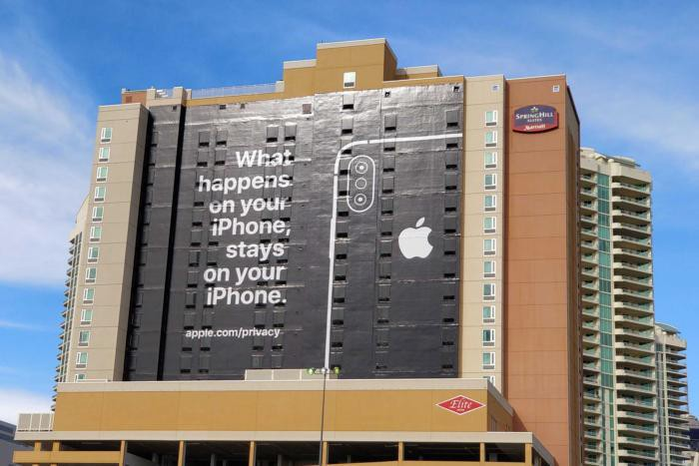
全部是新闻

Slide 7

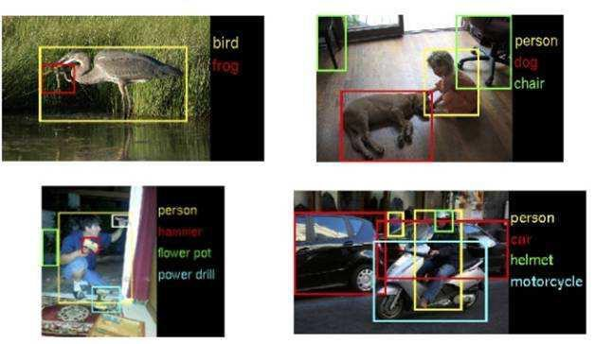

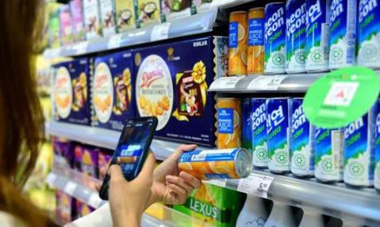
Challenges to AI：small data and fragmented data, Non-iid, Non-balanced, non-cooperative or malicious, dirty data, incomplete data, outdated data…
Data silos
Enterprise A
Enterprise B
X1
(X2, Y)
Low Security in Data Sharing Lack of Labeled Data Segregated Datasets
Over 80% of the worlds’ enterprise information are in
data silos!

Slide 8





Slide 9
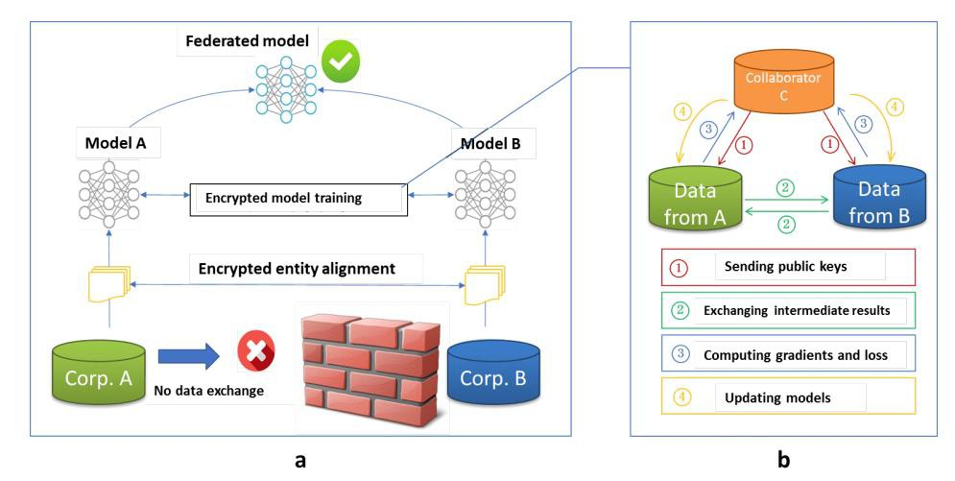
Federated Learning
Qiang Yang et al, Federated Learning, Morgan & Claypool Publishers, 2019, section 1.2, page 3
Move models instead of data; Data usable but not visible.
Multi-party model learning without exchanging data.
Scenarios:
Collaboration among edge devices,
Collaboration among organizations,
Collaboration among departments within one organization.
Also known as:
Federated Machine Learning
Collaborative Machine Learning
Federated Deep Learning
Federated Optimization
Privacy-preserving Machine Learning
Geo-distributed Machine Learning
Geo-distributed Deep Learning
Multi-party Learning
References:
[Kairouz’19] Peter Kairouz, and H. Brendan McMahan, et. al., "Advances and Open Problems in Federated Learning," Dec. 2019. Available: https://arxiv.org/abs/1912.04977
[Yang’19] Qiang Yang, et al., "Federated Machine Learning: Concept and Applications," Feb.
2019.
[McMahan’16] H. Brendan McMahan, et al., “Federated Learning of Deep Networks using
Model Averaging," Feb. 2016.
[Konecny’15] Jakub Konečný, Brendan McMahan, and Daniel Ramage, "Federated Optimization: Distributed Optimization Beyond the Datacenter," Nov. 2015. Available: https://arxiv.org/abs/1511.0357

Slide 10
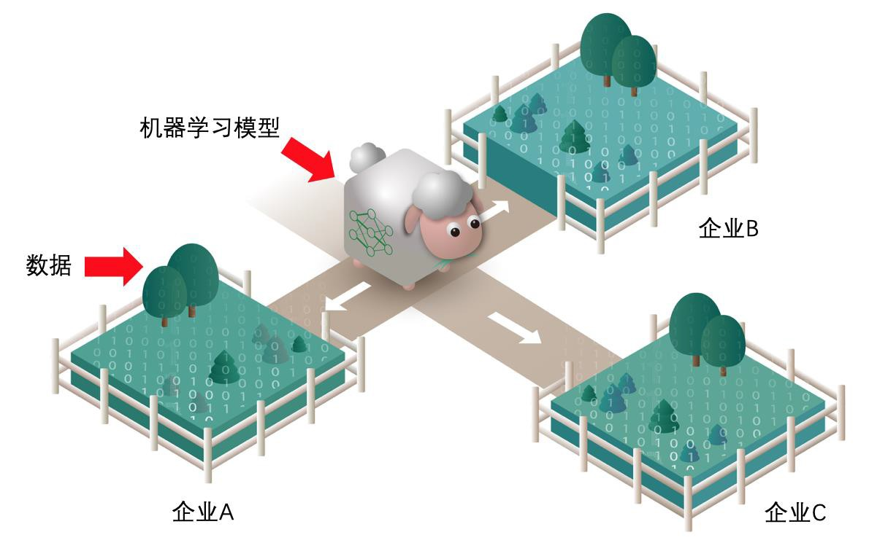
Definition of Federated Learning-2
Qiang Yang et al, Federated Learning, Morgan & Claypool Publishers, 2019, section 1.2.1, page 4-7
Interpretation of Federated Learning:
Models --- Sheep
Data --- Grass
Originally, one need to purchase grass from different sources to feed sheep ---
Companies gather lots of data to train models, where many challenges exist, such as user
privacy, data security and regulations.
Federated Learning provides an alternative: sheep are led to different farms and can thus eat grass from all places without having to move the grass. --- Federated learning models gather knowledge from various sources of data without having to observe them.
ML Models
Corporation B
Data
Corporation A
Corporation C

Slide 11

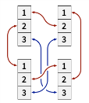
Key Components in Federated Learning
<<Book: Federated Learning>>
Model design and hyperparameter tuning, e.g. number of layers, CNN or RNN, etc.
Distributed learning algorithm (Chapter 3), e.g. client selection, tackling non-IID (or even contradictory) training data,
system-algorithm co-design, etc.
Communication optimization, e.g. alleviating the influence of network delay, model/gradient compression, etc.
Security and privacy (Chapter 2), e.g. Homomorphic Encryption (HE), Differential Privacy (DP), Secure Multi-party Computation (MPC), etc.
Incentive mechanism (Chapter 7), e.g. motivating organizations from different industries, adequate revenue
allocation, etc.
Model Design
Communication
Privacy & Security
Distributed ML
Incentive
Image from Google

Slide 12
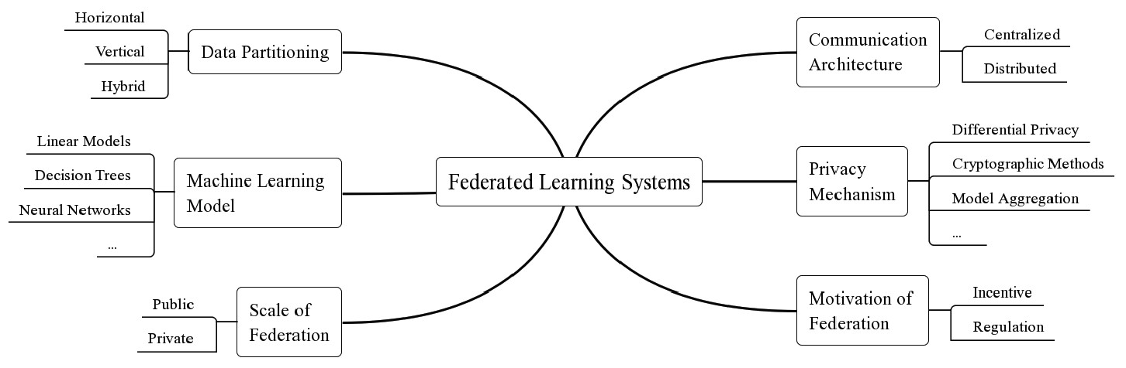
Taxonomy of federated learning systems (FLSs)
[Li’19] Qinbin Li, Zeyi Wen, et al., “Federated Learning Systems: Vision, Hype and Reality for Data Privacy and Protection,” Oct. 2019. https://arxiv.org/abs/1907.09693

Slide 13
Federated Learning System: Overview
Federated Optimization and Learning Algorithms
HFL
(Horizontal)
VFL
(Vertical)
FTL
(Transfer)
Cross-site Communication
Incentive Mechanism
Preventing any info leakage
HE
DP
MPC
Defense against model/data poisoning attacks
FL has built-in mechanism for robustness, such as
defending model/data poisoning attacks.
FL is more than what “MPC+ML” is about.
The built-in MPC block in FL can prevent any
info leakage (either model or data leakage).
FL can do whatever “MPC+ML” can do.

Slide 14
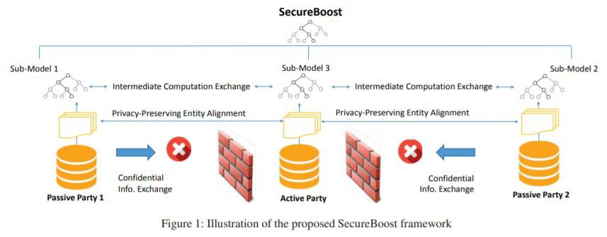
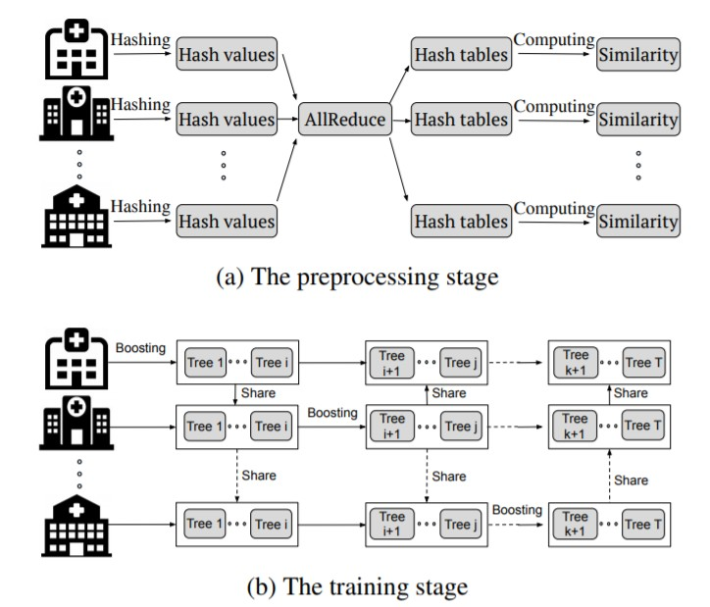
Secureboost in VFL
GBDT in HFL
Kewei Cheng, Tao Fan, Yilun Jin, Yang Liu, Tianjian Chen, Qiang Yang, SecureBoost: A Lossless Federated Learning Framework, IEEE Intelligent Systems 2020
Qinbin Li, Zeyi Wen, Bingsheng He, Practical Federated Gradient
Boosting Decision Trees, AAAI, 2019

Slide 15
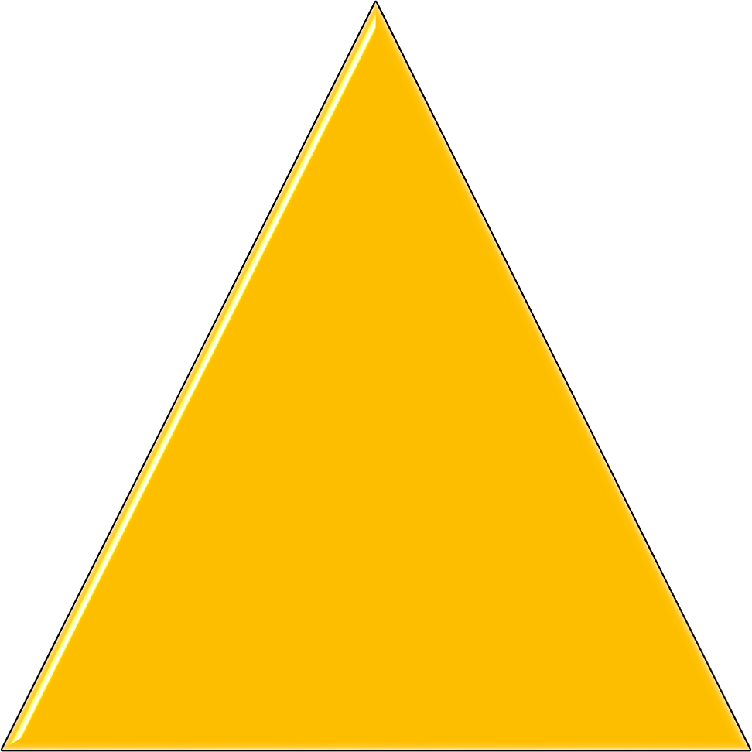

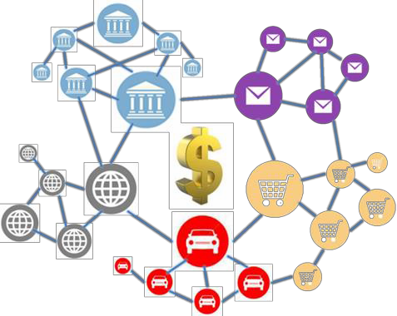


Federated Learning: research areas
Security and Laws
Safety Efficiency Applications Incentives

Slide 16
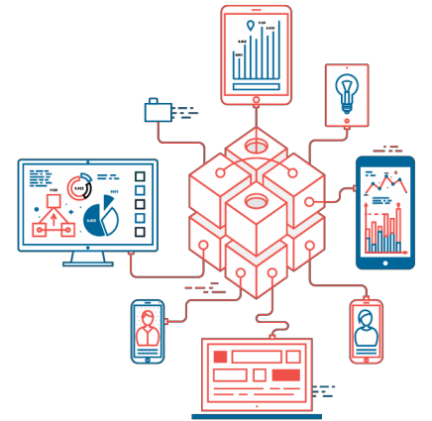

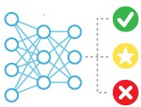

Federated Learning Market Games
4.分配收益
2.训练联邦
模型
数据 孤岛
1.选择联邦加入
数据 联邦
3.产生收益
数据 孤岛
… …
… …
… …
2.训练联邦 模型
数据 孤岛
数据 联邦
3.产生收益
1.选择联邦加入
4.分配收益

Slide 17

Federated Learning Applications
Federated Learning + Other ML Algorithms (Chapter 8)
Federated learning + Computer vision (FL+CV)
Federated learning + Natural language processing (FL+NLP), including automatic speech recognition (ASR)
Federated learning + Recommender system (FL+RS)
Federated Learning + Industry/Society, (Chapter 10 and cases from WeBank: https://www.fedai.org/cases/)
Federated learning + Finance, FinTech
Federated learning + Insurance, InsurTech
Federated learning + Healthcare
Federated learning + Education
Federated learning + AIoT
Federated learning + Smart City
Federated learning + Edge computing
Federated learning + 5G/6G
Reference:
GitHub, innovation-cat/Awesome-Federated-Machine-Learning, Available: https://github.com/innovation-cat/Awesome-Federated- Machine-Learning
https://zhuanlan.zhihu.com/p/87777798

Slide 18
Federated Learning Datasets
WeBank FedVision - Street Dataset, Available: https://dataset.fedai.org/#/
A real-world object detection dataset that annotates images captured by a set of street cameras based on object present in them, including 7 classes. In this dataset, each or every few cameras serve as a device.
Carnegie Mellon University, LEAF: A benchmarking framework for federated learning,
Available: https://leaf.cmu.edu/, https://github.com/TalwalkarLab/leaf
● Federated Extended MNIST (FEMNIST ), 62 classes, Image Classification
● Twitter, Sentiment140, Sentiment Analysis, federated
● Shakespeare, Next-Character Prediction, federated
● Celeba, Image Classification (Smiling vs. Not smiling), federated
● Synthetic Dataset, Classification, federated
University of Southern California: FedML (Chaoyang He et al.)

Slide 19
Federated Learning Open-source Platforms
Qiang Yang et al, Federated Learning, Morgan & Claypool Publishers, 2019, section 1.3.2, page 11-13
WeBank FATE, supports TensorFlow and PyTorch, https://github.com/FederatedAI/FATE
Google TensorFlow Federated (TFF) , https://github.com/tensorflow/federated
Google TensforFlow-Encrypted, https://github.com/tf-encrypted/tf-encrypted
PyTorch, torch.distributed, https://pytorch.org/tutorials/intermediate/dist_tuto.html
Uber Horovod, supports Keras, TensorFlow, PyTorch, and MXNet, https://github.com/horovod/horovod
coMindOrg, supports TensorFlow, https://github.com/coMindOrg/federated-averaging-tutorials
OpenMined PySyft, supports PyTorch, https://github.com/OpenMined/PySyft
MesaTEE by Baidu，https://mesatee.org/ https://mp.weixin.qq.com/s/1SXW1N7BaVnyFXFZ-f24TA
PaddlePaddle/PaddleFL by Baidu, https://github.com/PaddlePaddle/PaddleFL

Slide 20
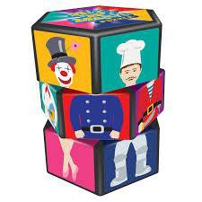
Privacy-Preserving Technologies
Secure Multi-party Computation (MPC)
Homomorphic Encryption (HE)
Yao’s Garbled Circuit
Secret sharing
Differential Privacy (DP)
……

Slide 21
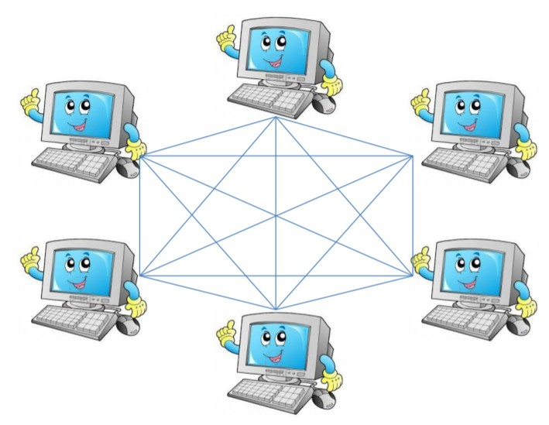
Secure Multi-Party Computation (MPC)
Provides security proof in a well- defined simulation framework
Guarantees complete zero knowledge
Requires participants’ data to be secretly-shared among non-colluding servers
Drawbacks:
Expensive communication,
Though it is possible to build a security model with MPC under lower security requirement in exchange for efficiency
Ran Cohen ,Tel Aviv University, Secure
Multiparty Computation: Introduction

Slide 22
Yao’s Garbled Circuit Protocol (Andrew Yao, 1986)
Oblivious Transfer
Alice input a
Bob input b
a₀
OT
i
Alice
Bob
Function f Garbled Circuit Protocol
a₁
a_{i}
Steps
Alice builds a garbled circuits;
Alice sends her input keys;
Alice and Bob do Oblivious Transfer;
Bob gets the output and sends back to Alice;
Alice and Bob learns nothing about the other value.
Alice gets f(a,b) but learns nothing about Bob
Bob gets f(a,b) but learns nothing about Bob
22

Slide 23


SecureML: Privacy-preserving machine learning for linear regression, logistic regression and neural network training
MPC
secret sharing
Combines secret sharing, garbled circuits and oblivious transfer
Learns via two un-trusted, but non- colluding servers
Computationally expensive
Mohassel, P., & Zhang, Y. (2017, May). SecureML: A system for scalable privacy-preserving machine learning. In 2017 38th IEEE Symposium on Security and Privacy (SP) (pp. 19-38). IEEE.

Slide 24
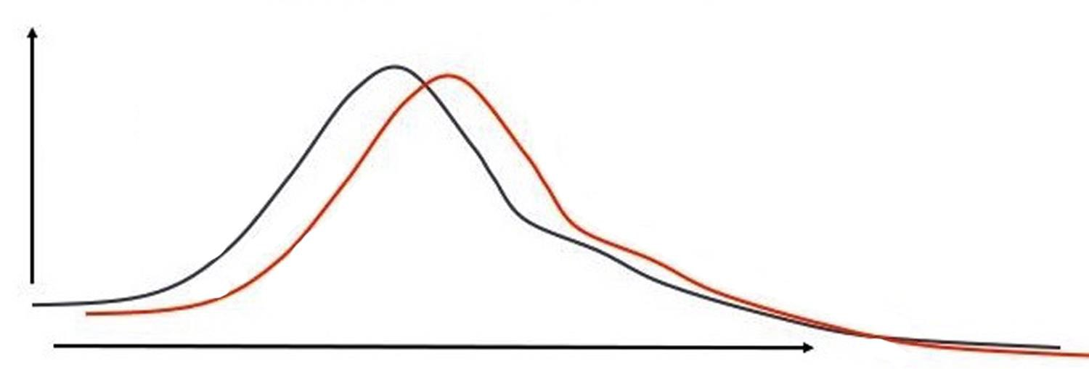
Differential Privacy
Definition: Differential Privacy (DP) [Dwork 2008]
A randomized mechanism M is ϵ-differentially private, if for all output t of M, and for all
databases D₁and D₂ which differ by at most one element, we have
Pr � 𝐷₁
= � = 𝑒^{𝜖}Pr � 𝐷₂ = � .
Pr � 𝐷₁
Pr � 𝐷₂
difference is small
Intuition: changes in the distribution are too small to be perceived with variations on a single element.
Cynthia Dwork, 2008. Differential privacy: a survey of results. Theory and Applications of Models of Computation.

Slide 25
Homomorphic Encryption
Full Homomorphic Encryption and Partial Homomorphic Encryption.
Paillier partially homomorphic encryption
Addition :
[[u]] + [[v]] = [[u+v]]
Scalar multiplication: n[[u]] = [[nu]]
For public key pk = n, the encoded form of m ∈ {0, . . . , n − 1} is
Encode(m) = r^{n} (1 + n) ^{m} mod n²
r is randomly selected from {0, . . . , n − 1}.
For float q = (s, e) , encrypt [[q]] = ([[s]], e), here q = sβ^{e} is base-β exponential representation.
Rivest, R. L.; Adleman, L.; and Dertouzos, M. L. 1978. On data banks and privacy homomorphisms.
Foundations of Secure Computation, Academia Press 169–179.

Slide 26
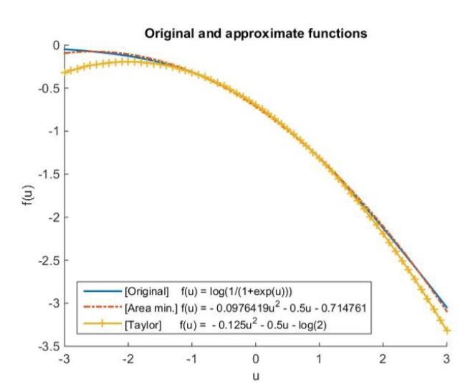
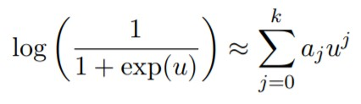
Applying HE to Machine Learning
Polynomial approximation for logarithm function
Encrypted computation for each term in the
polynomial function
loss = log 2 − ¹ yw^{T} x + ¹ (w^{T} x)²
2 8
[[loss]] = [[log 2]] + (− ¹)*[[ yw^{T} x]] + ¹ [[(w^{T} x)² ]]
2 8
Kim, M.; Song, Y.; Wang, S.; Xia, Y.; and Jiang, X. 2018. Secure logistic regression based on homomorphic encryption: Design
and evaluation. JMIR Med Inform 6(2)
Y. Aono, T. Hayashi, T. P. Le, L. Wang, Scalable and secure logistic regression via homomorphic encryption, CODASPY16

Slide 27

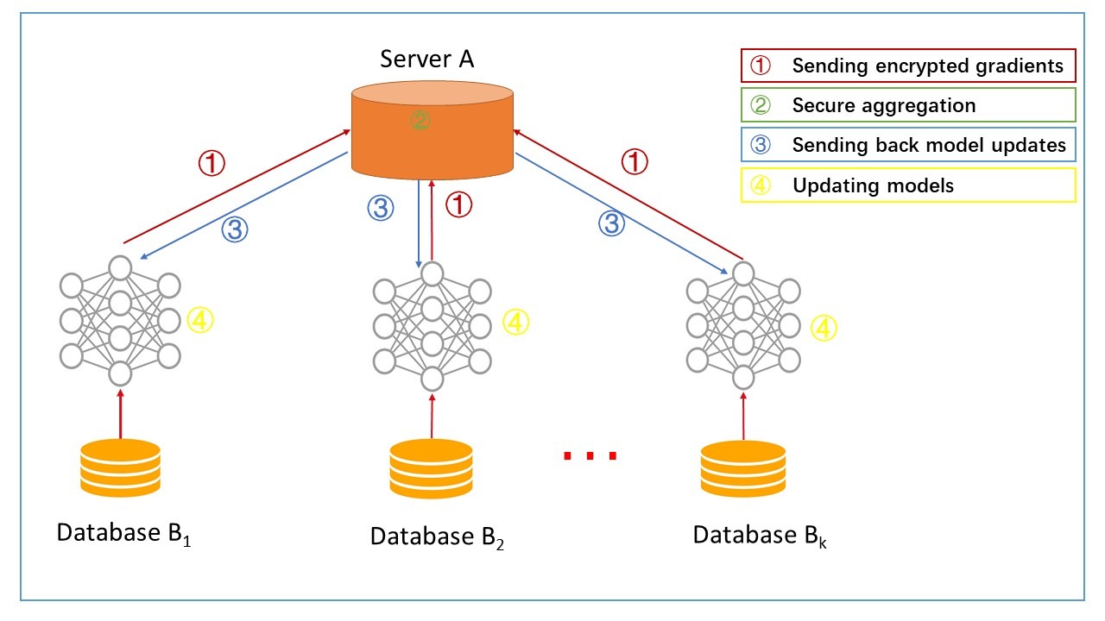
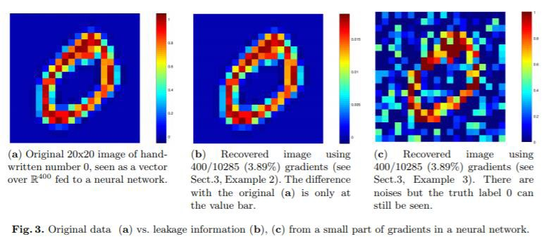







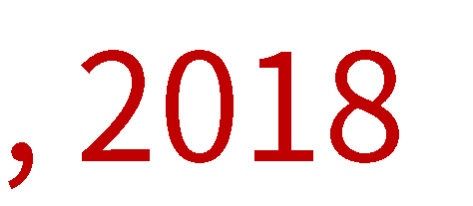
Is the Gradient Info Safe to Share?
Le Trieu Phong, et al. 2018. Privacy-Preserving Deep Learning via Additively Homomorphic Encryption. IEEE Trans. Information Forensics and Security，13, 5 (2018),1333–1345

Slide 28
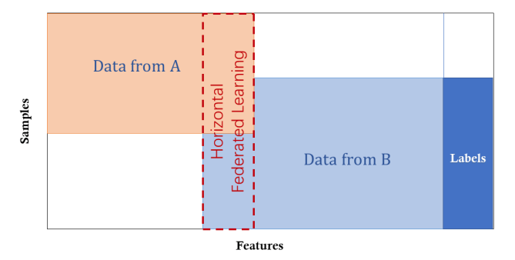
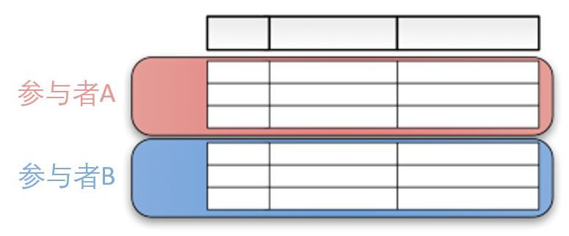
Horizontal Federated Learning, HFL
Qiang Yang et al, Federated Learning, Morgan & Claypool Publishers, 2019, section 1.2.2, page 7-10
Parties own data with overlapping features, i.e. aligned feature space; yet the training samples are different.
Also known as “cross-sample federated learning”, “feature-aligned federated learning”.
The feature space is identical.
HFL expands the number of training samples, with the feature dimensionality unchanged.
Party A
Party B
Image from Google
References:
[Kairouz’19] Peter Kairouz, and H. Brendan McMahan, et. al., "Advances and Open Problems in
Federated Learning," Dec. 2019. Available: https://arxiv.org/abs/1912.04977
[Yang’19] Qiang Yang, et al., Federated machine learning: Concept and Applications, WeBank, 2019.
[Google’19] Google Federated Learning Comic, https://federated.withgoogle.com/
Horizontally partitioned data: data frames are partitioned horizontally into rows, each of which having the same features.
28
All rights reserved. No distribution without permission

Slide 29
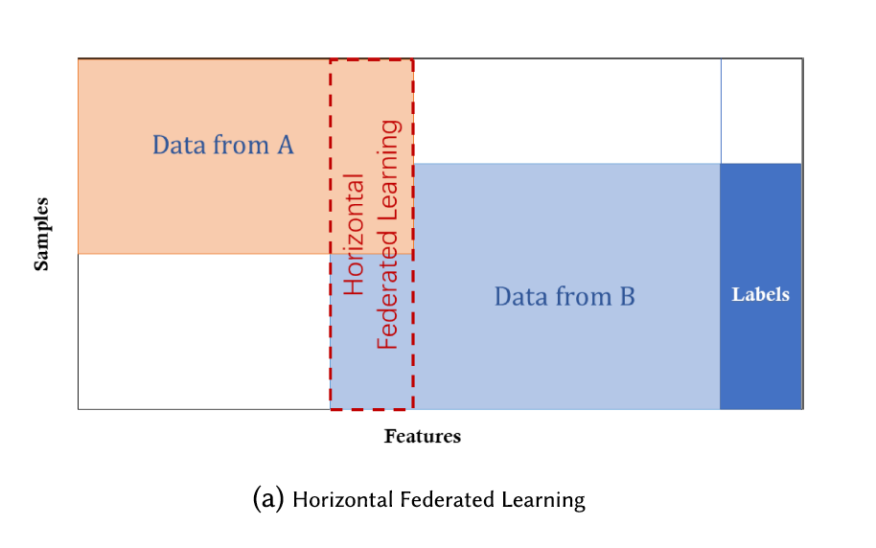
Horizontal Federated Learning: Divide by Users/Samples
Step 1: Participants compute training
gradients locally
mask gradients with encryption, differential privacy, or secret sharing techniques
all participants send their masked results to server
Step 2: The server performs secure aggregation without learning information
about any participant
Step 3: The server sends back the aggregated
FEDERATED LEARNING FOR MOBILE KEYBOARD
PREDICTION, Andrew Hard, et al., Google, 2018
results to participants
Step 4: Participants update their respective model with the decrypted gradients
29

Slide 30
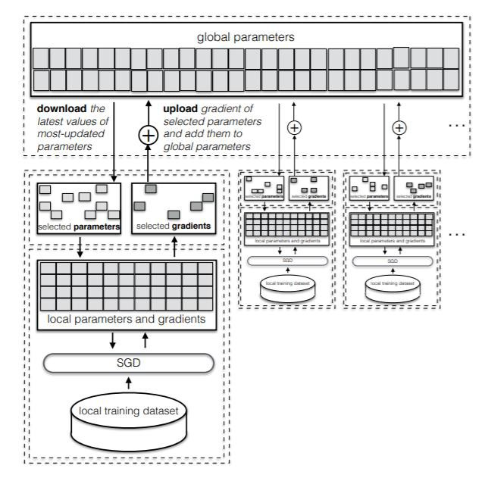
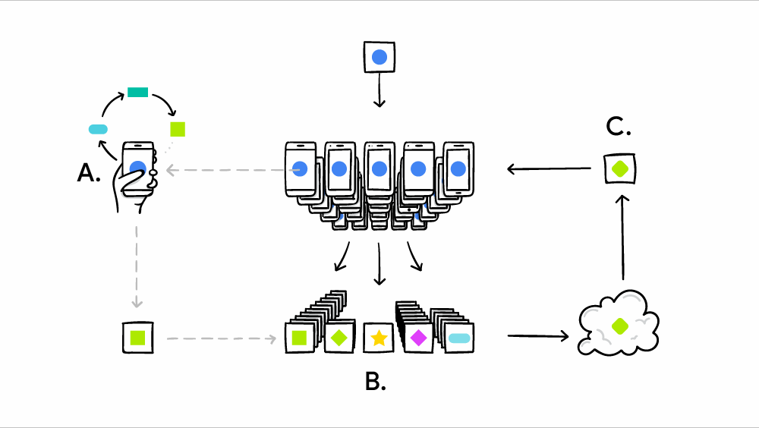
Horizontal Federated Learning
H. Brendan McMahan et al, Communication-Efficient Learning of Deep Networks from Decentralized Data, Google, 2017
Multiple clients, one server
Data is horizontally split across devices, homogeneous
features
Local training
Selective clients
Reza Shokri and Vitaly Shmatikov. 2015. Privacy-Preserving Deep Learning. In Proceedings of the 22Nd ACM SIGSAC Conference on Computer and Communications Security (CCS ’15). ACM, New York
30

Slide 31
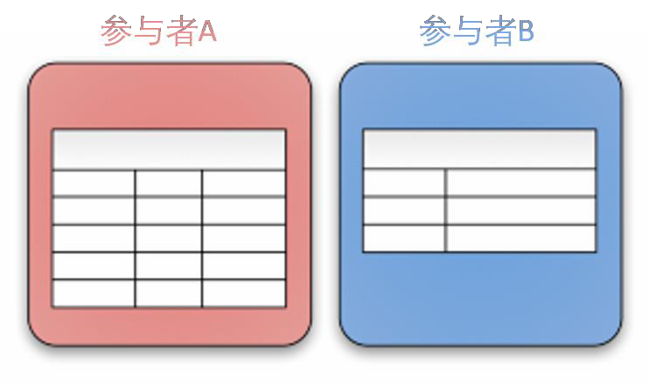
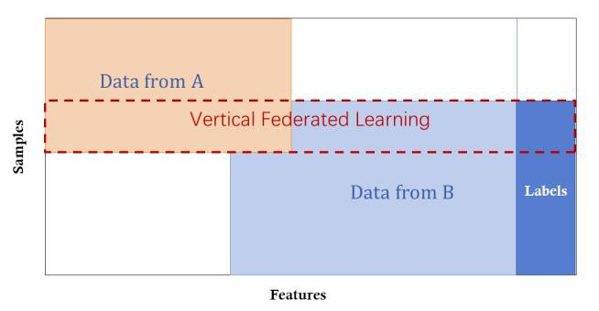
Vertical Federated Learning, VFL
Qiang Yang et al, Federated Learning, Morgan & Claypool Publishers, 2019, section 1.2.2, page 7-10
Parties hold data with identical data ID (i.e. training samples), but with different features.
A.k.a “Cross-feature federated learning”, “sample-aligned federated learning”. Suitable for federated learning across industries.
Before training, we take the intersection of data IDs held by different parties.
VFL increases data dimensionality at the cost of sample size (due to intersection of IDs).
Party A
Party B
Image from Google
Vertically partitioned data: partition data frames into columns, with each column holding the same feature.
[Yang’19] Qiang Yang, et al., Federated machine learning: Concept and Applications, WeBank, 2019.
All rights reserved. No distribution without permission
31

Slide 32



Vertical Federated Learning
Objective:
Party (A) and Party (B) co-build a FML model
(X)
(U, Z)
Assumptions：
Only one party has label Y
Neither party wants to expose their X or Y
(V, Y)
ID
X1
X2 X3 ID | X4 | X5 | Y
80 600 U1 | 6000 | 600 | No
50 550 U2 | 5500 | 500 | Yes
35 520 U3 | 7200 | 500 | Yes
100 600 ^{U4} | 6000 | 600 | No
75 600 ^{U8} | 6000 | 600 | No
75 520 ^{U9} | 4520 | 500 | Yes
80 600 ^{U10} | 6000 | 600 | No
Challenges:
Parties with only X cannot build models
Parties cannot exchange raw data by law
U1
9
U2
4
U3
2
U4
10
Expectations：
Data privacy for both parties
model is LOSSLESS
U5
5
U6
5
U7
8
Retail A Data
Bank B Data
32

Slide 33






Privacy-Preserving Entity Match
Party A and B learns their overlapping IDs but nothing else
Party A
Party B
ID list X
� ∩ �
ID list Y
33

Slide 34
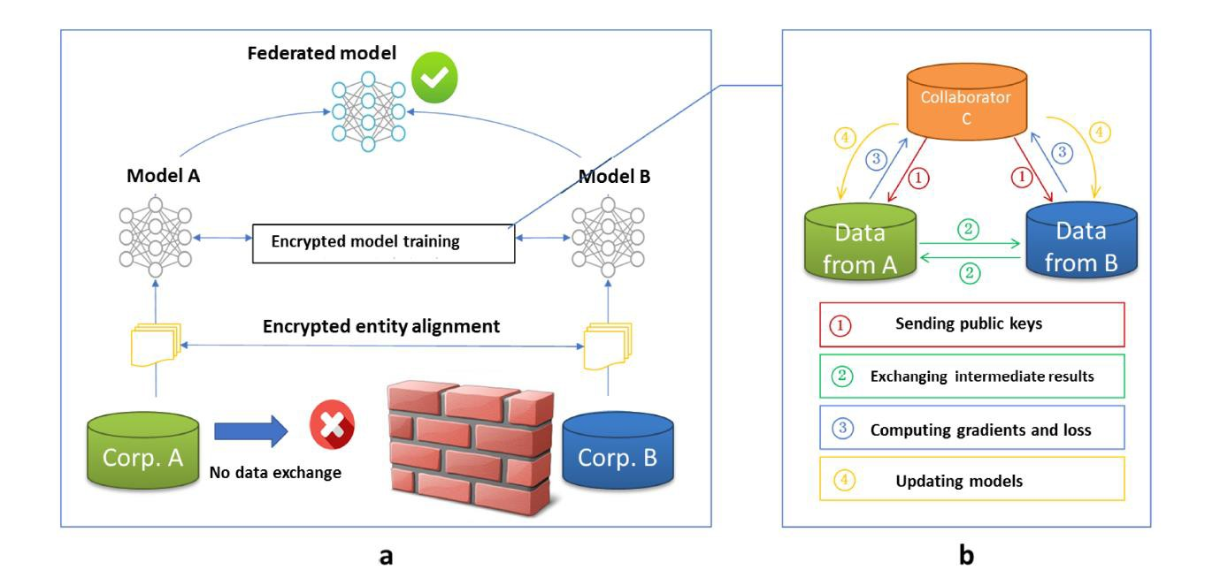
Vertical Federated Learning
Federated Transfer Learning: Concepts and Applications.
Qiang Yang, Yang Liu and Tianjian Chen. ACM TIST 2019.
34

Slide 35




Privacy-Preserving inference
Suppose a new user ID arrives at Party B,
Step 1
Party B sends encrypted ID to A
Encrypted ID matching
Step 2
Party A and B compute local results
sends sub-model score U_{A}
Step 3
Party A sends its results to B
Yes
Add sub-model
scores U_{A}+U_{B}
Find ID ?
No
Step 4
Party B combines results
Sends end signal
35

Slide 36
Security Analysis
Security against third-party C
all C learns are the masked gradients and the randomness and secrecy of the masked matrix are guaranteed
Security against each other
Party A learns its gradient at each step, but this is not enough for A to
learn any information from B
inability of solving n equations in more than n unknowns
Security in the semi-honest setting

Slide 37
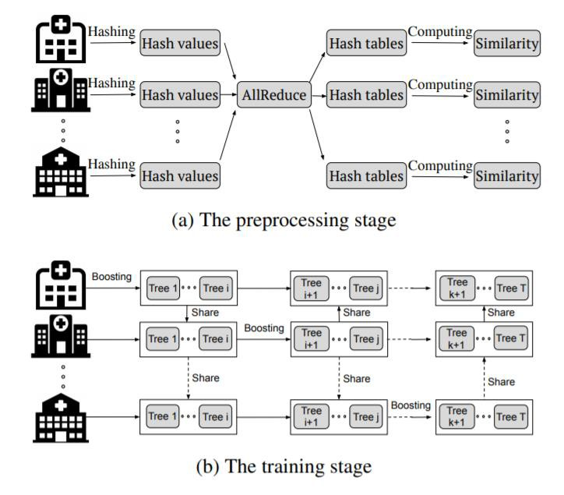
XGBoost in Federated Learning
GBDT in HFL
Kewei Cheng, Tao Fan, Yilun Jin, Yang Liu, Tianjian Chen, Qiang Yang, SecureBoost: A Lossless Federated Learning Framework, IEEE Intelligent Systems 2020
Qinbin Li, Zeyi Wen, Bingsheng He, Practical Federated Gradient Boosting Decision Trees, AAAI, 2019

Slide 38
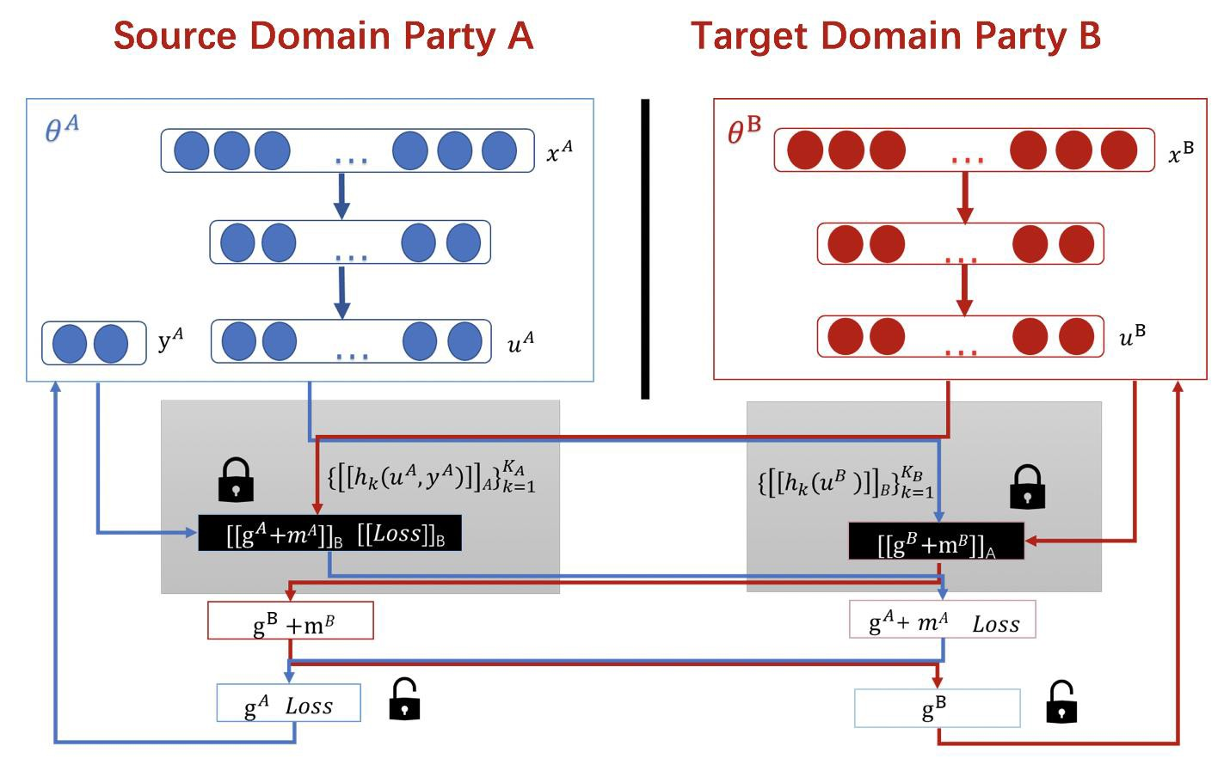
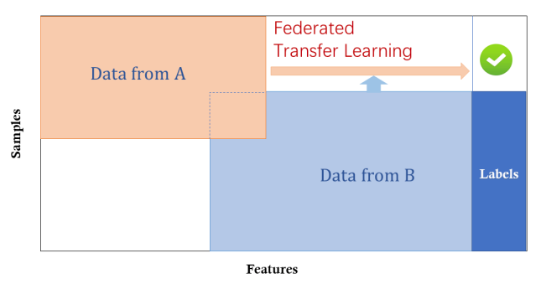
Federated Transfer Learning, FTL
Qiang Yang et al, Federated Learning, Morgan & Claypool Publishers, 2019, section 1.2.2, page 7-10
Parties hold data with different ID and different features (some parties may not have labels).
Suitable for federated learning across industries.
Common methods include model transfer, instance transfer, feature transfer and domain adaptation, etc.
Peer-to-peer architecture is commonly used.
FTL is important to solving the problem of ‘small data’ and ‘unlabeled data’.
[Yang’19] Qiang Yang, et al., Federated machine learning: Concept and Applications, WeBank, 2019.
[Liu’19] Yang Liu, et al., Secure Federated transfer learning, WeBank, 2018.
38
All rights reserved. No distribution without permission

Slide 39
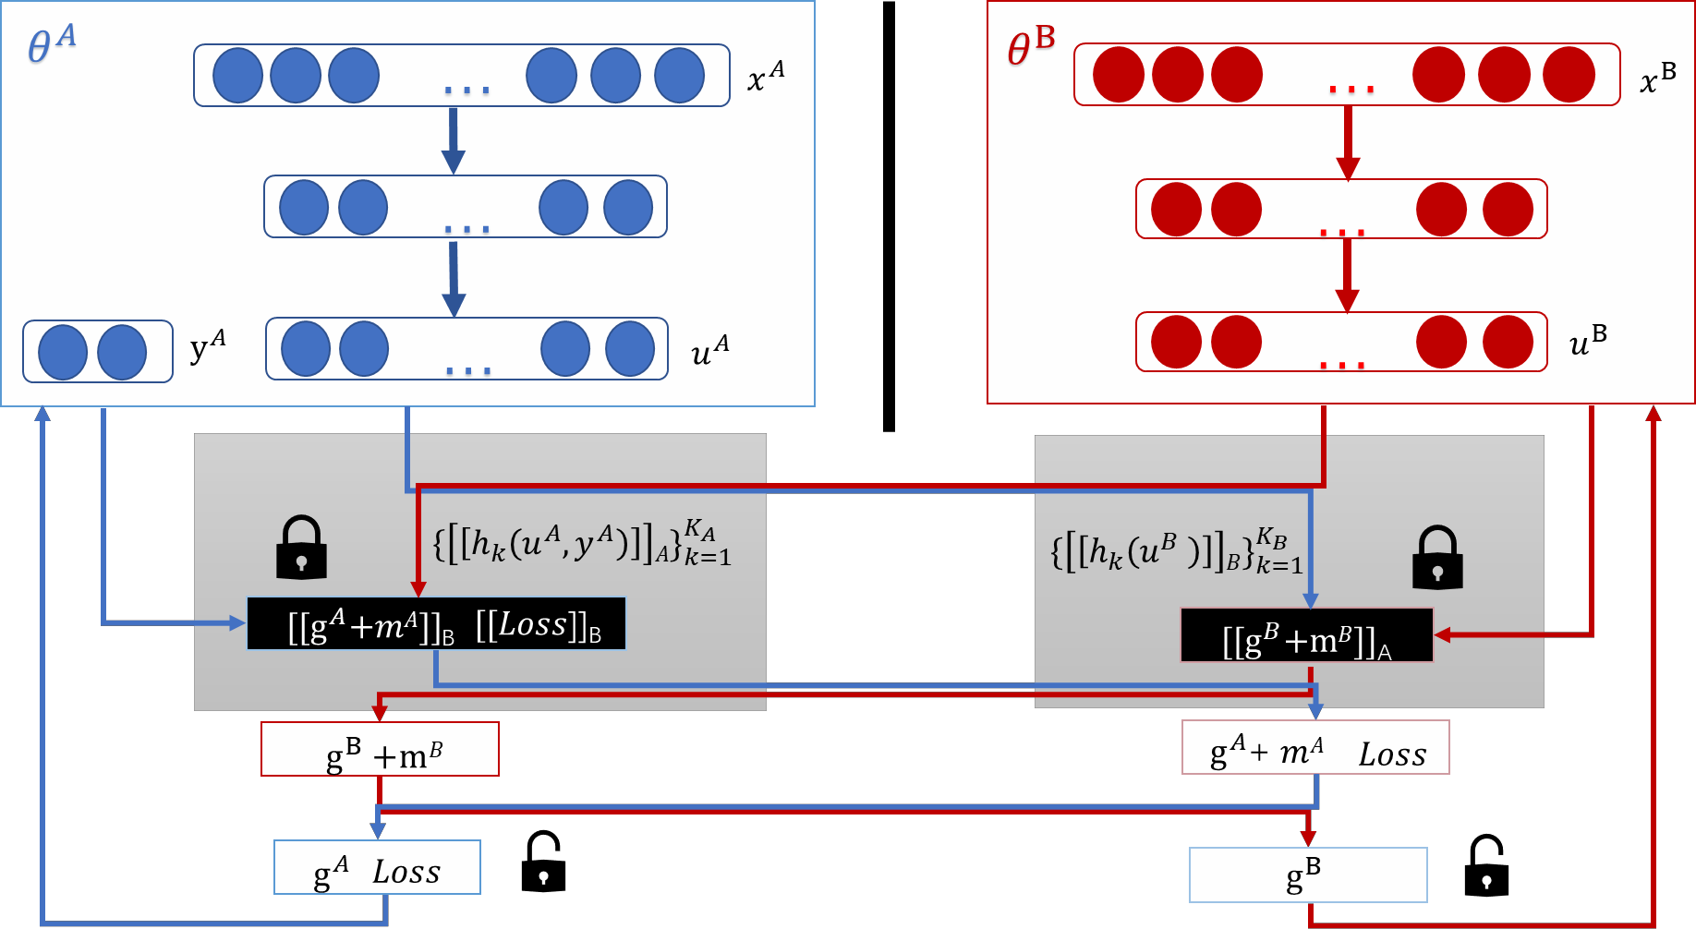
Federated Transfer Learning
Source Domain Party A Target Domain Party B
Step 1
Party A and B send public keys to each other
Step 2
Parties compute, encrypt and exchange intermediate results
Step 3
Parties compute encrypted gradients, add masks and send to each other
Step 4
Parties decrypt gradients and exchange, unmask and update model locally
Federated Transfer Learning. Yang Liu, Tianjian Chen, Qiang Yang, https://arxiv.org/pdf/1812.03337.pdf 2018

Slide 40
Efficiency: BatchCrypt: Efficient Homomorphic Encryption for Cross-Silo Federated Learning
Reducing the encryption overhead and data transfer
Quantizing a gradient value into low-bit integer representations
Batch encryption: encoding a batch of quantized values to a long integer
BatchCrypt is implemented in FATE and is evaluated using popular deep learning models
Accelerating the training by 23x-93x
Reducing the netw. footprint by 66x-101x
Almost no accuracy loss (<1%)
LSTM
C. Zhang, S. Li, J. Xia, W Wang, F Yan, Y. Liu, BatchCrypt: Efficient Homomorphic Encryption for Cross-Silo Federated Learning, USENIX ATC’20 (accepted)

Slide 41





Incentivize Parties to Join: Federated Learning Exchange
Observation: The success of a federation depends on data owners to share data with the federation
Challenge: How to motivate continued participation by data owners in a federation?
Research Question: How to determine �_{𝑖}(�)?
��(�)
�₁(�)
�_{𝑖}(𝒕)
Revenue from FL customers
Limited Budget for Utility Transfer to data owners at
Data Owner 1
FL Model
Data Owner i … ... Data Owner N
Dataset
•Qiang Yang, Yang Liu, Tianjian Chen, Yongxin Tong:
t, 𝐵(�)
Federated Machine Learning: Concept and Applications. ACM TIST 10(2): 12:1-12:19 (2019)

Slide 42
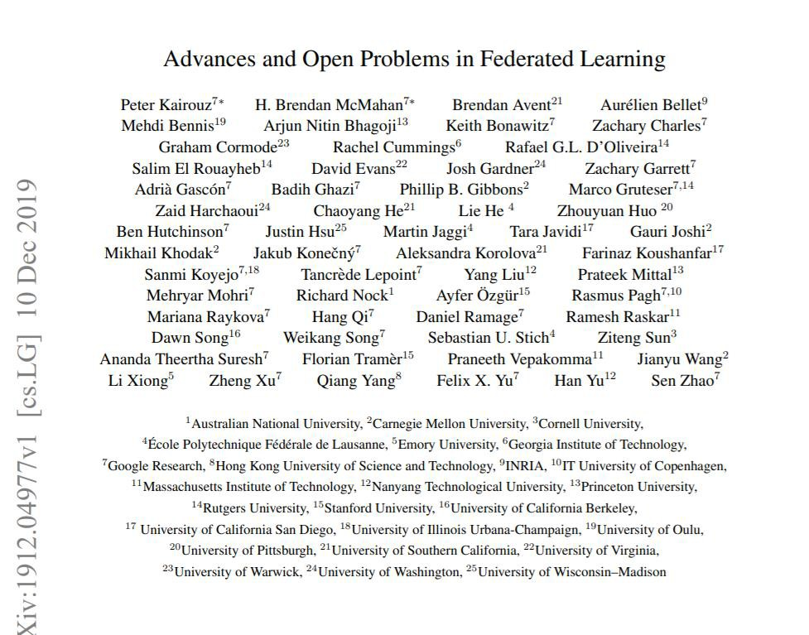

42

Slide 43




Applications
Anti money laundering
Internet + insurance Insurance pricing
Internet + retailers Intelligent marketing
Internet + banking Risk modeling
recall improves 15%
Audit efficiency
improved by over 50%
Pricing model improves accuracy
Coverage ratio is over
90%
Marketing efficiency
improves greatly;
Better user profile and targeting;
Performance keeps increasing with respect to the enriched features
43

Slide 44


Risk Management with Federated Learning
Other Enterprise WeBank
ID 纳税人识别号 | X1 近3个月开票金额 | X2 近6个月开票金额
U1 | 90 | 150
U2 | 40 | 100
U3 | 20 | 80
U4 | 100 | 200
U9 | 50 | 50
U10 | 6 | 10
U11 | 2 | 5
ID 纳税人识别号 | X3 央行征信分 | Y 逾期概率
U1 | 600 | 0.79
U2 | 550 | 0.11
U3 | 520 | 0.88
U4 | 600 | 0.15
U5 | 600 | 0.90
U6 | 520 | 0.81
U7 | 600 | 0.32
60
Million
400 K
发票数据衍生变量
200 Dimensions
20 dim
tax | bank | business
44

Slide 45
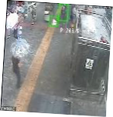
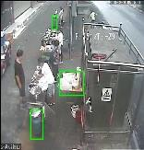
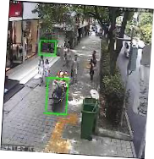

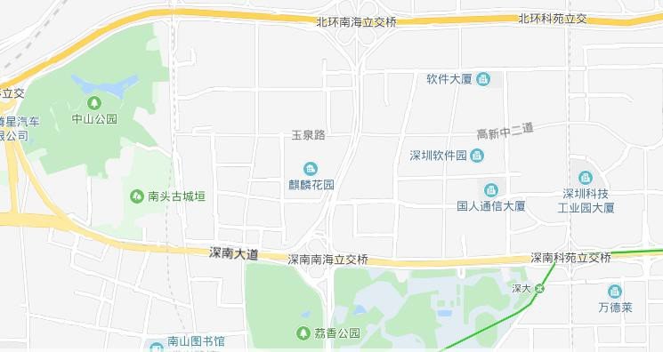
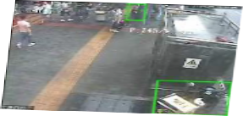
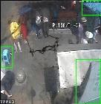
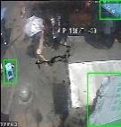
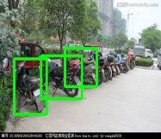
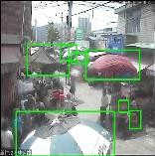
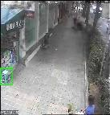
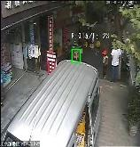

Construction-Site Safety w/ Federated Computer Vision
Webank AI X Extreme Vision

Slide 46



Federated Recommendation
Recommender System
Assumption: a trustworthy 3rd-party as coordinator, which can be removed

Slide 47





Horizontal Federated Recommendation
Example: movie recommendation with data from individual users
Party A
Party B
Party C
47

Slide 48






Federated Collaborative Filtering [Ammad et al. 2019]
Intuition: decentralized matrix factorization, each user profile is updated locally,
item profiles are aggregated and updated by coordinator
Party A
User 1
�₁
…
…
User k
�_{𝑘}
…
Party B
…
𝒗
User n
�_{𝑛}
Ammad-ud-din, et al. 2019. Federated Collaborative Filtering for Privacy-Preserving Personalized Recommendation System. arXiv:1901.09888.

Slide 49

Voice Recognition using Multiple Data Sources
TFE= Transfer + Federated + Evolutionary
1
Vendor仅可 以根据Client 提供的文本信 息微调语言模 型
2 3
Client需要给 Vendor暴露 明文数据来微 调ASR
Vendor和 Client之间只 存在购买这一 单向行为
传统 语音 识别
WeBank- ASR支持 Vendor和 Client之间存 在购买和回馈 双向行为，实 现共赢的生态 闭环
WeBank- ASR实现了语 言模型和声学 模型同时深度 定制
WeBank- ASR实现了对 Client数据的 隐私保护
基于
TFE
的语
音识
别
Reduced error by 10%~20%

Slide 50


Federated Learning Eco-Systems in B2B Markets: at WeBank
First Industrial Strength Enterprise Federated Learning System
Awards
AAAI 2020 Industry Award
稳定运行2年以上，数十家客户落地运行
100 Million Level Data Processing, 2000+ Features Credit Rating in Banking : 12 scearios
SaaS Queries
40 Million
支持亿级数据隐私保护交集算法， 支撑 20+ 联邦学习算法生产应用， 超4000万在线调用
Eco systems
530+ organizations
同比上涨96%，覆盖 370 家 企业机构，164 所高校
Patents
74 Approved
In applications: > 400，
Standards
5项标准制定
其中2项国际标准，3项 国内标准
Textbooks
《联邦学习》
联合中国银联、鹏城实验室、 平安科技等共同发布了《联邦 学习白皮书2.0》

Slide 51


Anti-money Laundering
银行
1
银行
2
互联网 公司
银行交易数据
横向联邦
移动支付和轨迹数据
纵向联邦
✓ 转账
✓ 支付
✓ ……
✓ 电商购物
✓ 地图轨迹
✓ ……
银行
3
通过横向联邦扩充反洗钱样本，构建基础反洗钱模型
通过纵向联邦扩充客户特征维度，进一步优化模型效果

Slide 52

多方数据本地建模
联邦建模
联邦评分
分数对应资质好坏 反欺诈/贷前评分/贷后监测
反欺诈评分举例 模型效果： AUC=0.70 KS=30，尾部分组坏样本比例是平均样本比例的2.4倍 使用方式：1）单一策略；2）入模变量；3）决策矩阵
互联网公司 金融科技公司
联邦学习建模
数据服务公司
第三方支付
银行 小贷公司
持牌消费金融公司 新型互联网消费金融
安全联合多方多维数据，提高AI模型精度

Slide 53

Insurance Industry
WeBank and Swiss Re
协助再保公司建立承保人（保险公司）的车险索赔概率模型：纵向联邦引入和挖掘互联网大数据 “从人因子”， 横向联邦扩大承保人传统因子数据集规模，从而实现对车主进行精准画像和风险分析
Internet Data
✓ 出行数据
✓ 消费数据
✓ 信息偏好
✓ 车辆违章数据
✓ ……
保险 公司1
Insurance
✓ 承保数据
✓ 理赔数据
✓ 车联网数据
✓ ……
互联 网公 司
横向联邦
保险 公司N
纵向联邦
保险 公司2

Slide 54





Federated Recommendation
Example: movie and book recommendation with data from two different data sources
Party A
Party B
联合建模、预测示意图
—— 安全合规的数据合作
过程
数据提供方
FDN系统
联合建模
推荐系统
加密ID匹配
第三方数 据
加工
全量ID、 特征变量、 表现数据
抽样
样本 数据
输出ID交集
样本 数据
抽样
全量ID、 特征变量、 表现数据
加工
推荐方数 据
模型训练
生成联合模型
反馈
反馈
离线全量预测
合作方
半模型
推荐方 半模型
离线全量预测
联合预测
注：客户ID包括但不限于客户身份证号码、 手机号、设备ID（imei）等； 联合建模过 程由拥有Y（表现数据）的一方发起；
业务系统
在线预测
在线预测
业务系统

Slide 55































IoT Applications
Perception engine analysis engine recognition engine
Sensor & edge computing
Fog computing
Cloud computing
Client

Slide 56






FedEdge: Federated Edge Computing
无人车公司A
无人车公司B
无人车公司C
数据量大，无法实时传输
数据隐私无法共享

Slide 57





Computer Vision using Federated Learning
装备制造业、物联网AIOT、智慧安防等行业，依托联邦学习，进行视觉市场的场景拓宽
优势：
• 相对于本地建模进一步提升算法准确率
• 形成网络效应，降低长尾应用成本，提升视觉业务总体利润率
FedVision –由联邦学习提供支持的在线视觉对象检测平台
Tasks:” 行人检测 出行检测 区域检测 设备异常检测 安全帽检测 火焰检测 烟雾检测
…….
Reinforcem
Vision
Cities
Local models are limited
Federated Vision improves accuracy by 15%

Slide 58













IEEE International Standard for Federated Learning
https://sagroups.ieee.org/3652-1/

Slide 59




More Standards
China Communications Standards Association
《基于联邦学习的数据流通产品 技术要求与测试方法
Data circulation products based on federated learning: Technical requirements and testing methods》
IEEE International Standard for Federated Learning
IEEE P3652.1
《Guide for Architectural Framework and Application
of Federated Machine Learning(联邦学习基础架构与应用)》
March 2021，The first international federated learning standard
20+ members
6 working group meetings
10 kinds of federated learning application scenarios specifications
……

Slide 60






WeBank AI: FATE - Federated Learning Open Source Platform
2月
微众AI 领衔推动联邦学 习国际标准制定
1月
微众AI亮相 AAAI 会议 发布联邦学习开源框架 FATE0.1版本
5月 主要合作伙伴切换到FATE
微众与瑞士再保险签订战略合 作协议，推动联邦学习在再保 险业应用
7月 微众AI牵头的国内 首个联邦学习标准正式 出台
8月 微众AI主导首个国 际联邦学习学术研讨会
6月 微众联邦学习开源 项目加入Linux基金会

Slide 61
Multi-Center Medical Modeling using Federated Learning
病例：58岁女性，有冠心病、高血压和多次头痛乏力病史、2017年11月30号因头晕四肢麻木被误诊颈椎病和眩晕综合征，模型预测卒中风险78%，最终于2018年5
月15号突发脑梗死住院
20150421 20170315
20171130 20180515
20151103 20160903
女性 58岁
冠心病
头痛
自主神经 疾病
高血压
眩晕综合 征/颈椎病
脑梗死
疾病诊断 医嘱处方 检验
检查 主诉 现病史
3年前 ←
2年前 ←
1年前 ←
→ 随访半年
模型预测时间点向前回溯记录
20151028
20160907
20171130
模型预测时间点: 20171231
血糖：9.55 mmol/L
神经科用药
预测风险：78%
20160519
无明显诱因出现 头晕、乏力，伴 四肢麻木，无视 物旋转、恶心、 呕吐
患者5个月后发生脑梗
Predication based on Time Series, Unstructured Data
10：00出现心慌，伴有胸闷，双 手发抖，无胸痛、呼吸困难，持 续不缓解，有高血压病史、冠心 病病史，无糖尿病史。有类似发 作史。体检：血压： 179/80 mmHg
20180515
患者半小时前突发意识障碍， 伴双上肢抽搐，以右侧肢体 为甚，呼之不能应答，立即 就诊卫生服务站，考虑急性 脑卒中，遂拨打16210接入院

Slide 62



Stroke Patients: How to Predict based on Symptoms?
Using Data from Multiple Diagnostic Centers
Records
Stroke Diagnosis
疾病
控制 良好
动脉硬化
症状
高脂血症
调脂
高血压
3级
房颤
检验
高血压
头晕
脑梗死
降压
糖尿病
3级
降糖
肢体麻木
脑出血
检查
糖尿病
控制 不好
乏力
手术
基础 慢病
用药
治疗
疾病
控制
症状 发作
终点 事件
家族史
年龄 性别
Timeline
社区卫生服务中心 → 医院A → 医院B

Slide 63
Stroke Patients: How to Predict based on Symptoms?
• 抽取2017-06-30至2017-12-31新发现脑卒中（包括脑梗、短暂性脑缺血发作、脑动供血不足、非创伤和血管畸形的脑 出血和蛛网膜下腔出血）病例，筛选在发病前至少有两次就诊记录者6502人
• 建立巢式病例对照研究队例：随机抽取与卒中就诊时间相同的其它就诊病例作为对照
发病前特征清洗抽取 巢式病例对照
预测 测试
回顾
机器学习模型
基础信息：年龄、性别 疾病诊断：高血压、糖尿病…. 症状提取：头部、胸部、肢体症 状 检验指标抽取：血脂血糖肝酶
检查指标抽取：B超心电图X片CT 用药：降压/抗凝/调脂/降糖
脑卒中
对照
脑卒中 风险等级 划分
新发现卒中在 之前是否被预 测高风险
Random Forest
GBDT
Logistic
regression
截止发病日期
回顾
2017-06-30至2017-
12-31新发病例

Slide 64





Stroke Patients: How to Predict based on Symptoms?
2017年12月底 风险排序
2018年1月至6月
5673人首次卒中
Prediction Results:
10级
• 根据脑卒中发病风险概率模型在2017年12月 底对全体人群进行预测和风险排序，设置10 个风险等级
9级
8级
7级
• 其中5673人在2018年1-6月期间首次发生脑 卒中，每10个发病者中有5人处于10级风险， 2人处于9级风险，1人处于8级风险，2人处于
6-7级风险，0人处于1-5级风险
6级
5级
4级
3级
2级
1级

Slide 65




Stroke Patients: How to Predict based on Symptoms?
Hube_{宜}i H_{昌}os_{市}pi_{脑}tal_{卒}s _{中风险预测}
Federated Learning
横向联邦学习系统结构
现状与挑战：医疗大数据模型面临数据孤岛难题 解决方案：联邦学习
成果：
● 完成多节点部署模型效果POC验证
● 提升了两家小医院D和E的模型AUC 10%和20%以上
● 共建联合实验室
某市TOP 5医院真实数据分布情况
联邦学习各模型AUC表现对比
联邦学习训练时间对比
Ce Ju et al., “The Privacy-preserving Technology to Help Millions of People: Federated Prediction Model for the Risk of
Stroke,”IJCAI Workshop on Federated Learning, 2020

Slide 66















Webank+Tencent Joint Team
•
•

Slide 67

FL-QSAR
An federated learning-based QSAR prototype for collaborative drug discovery
67
Shaoqi Chen et al. Qiang Yang, Qi Liu, 2020, Bioinformatics.

Slide 68

FL-QSAR
Federated Learning based New Drug Structure Discovery:
Accuracy same as putting the data all together.
FL Based platform: FL-QSAR
4-step training process：
（1）各制药机构方发送加密模型参数到聚合中心
（2）聚合中心进行参数聚合
（3）聚合中心将聚合后的参数发回各制药机构用户
（4）各制药机构用户使用聚合后的参数更新模型
Shaoqi Chen et al. Qiang Yang, Qi Liu, 2020, Bioinformatics.

Slide 69


FL-QSAR Experiments
14 QSAR data sets
Two or more distributed collaboration parties
Data imbalanced: three centers
Shaoqi Chen et al. Qiang Yang, Qi Liu, 2020, Bioinformatics.

Slide 70

Benchmark QSAR Data
Shaoqi Chen et al. Qiang Yang, Qi Liu, 2020, Bioinformatics.

Slide 71


FL-QSAR: Federated Learning Results
Balanced Cases Imbalanced Cases
Shaoqi Chen et al. Qiang Yang, Qi Liu, 2020, Bioinformatics.

Slide 72
Conclusion
HFL can achieve almost the same performance as collaboration via cleartext learning algorithms using all shared information.
Collaboration by HFL gained a substantially performance improvement than that of one client by using only its private data.
A prototype collaborative QSAR system based on FL is presented: https://github.com/bm2-lab/FL-QSAR.
Shaoqi Chen et al. Qiang Yang, Qi Liu, 2020, Bioinformatics.

Slide 73


Challenges for Federated Learning
Models [BVH+18]
Data [HAP17]
Eugene B et al. 2018. How To Backdoor Federated Learning. arXiv:cs.CR/1807.00459
Briland H et al. 2017. Deep Models Under the GAN: Information Leakage from Collaborative Deep Learning

Slide 74


New Direction: Auto Vertical Federated Learning
Image From a real person or his photo?
A Secure Face Database
②
Query(userID)
③
Net A
Net B
Bank APP
①
④
VFL Framework
√
❌
Banking Authentication：
Upload front camera photo: to judge whether an image is taken from a real person or his photo.
Bank A can cooperative with a a Secure Face Database with VFL;
What can AutoFL (Vertical) do：
To determine the learning architecture automatically and locally in a communication-efficient manner with data protection;

Slide 75




Privacy Attack Example: Deep Leakage.
Song Han from MIT designed Deep Leakage Attacks that tackle DP-protected models, and are able to reconstruct training data from gradients with pixel-level accuracy.
Reconstruct training data
Ground Truth
Ligeng Zhu, Zhijian Liu, Song Han. Deep Leakage from Gradients. In NeurIPS, 2019.

Slide 76



References
[McMahan’16] H. Brendan McMahan et al., “Communication-Efficient Learning of Deep Networks from Decentralized Data”, Google, 2016. [Bonawitz’19] Keith Bonawitz et al., “Towards Federated Learning at Scale: System Design”, Google, 2019.
[Su’18] H. Su and H. Chen. “Experiments on Parallel Training of Deep Neural Network using Model Averaging,” Jul. 2018. Available: https://arxiv.org/abs/1507.01239
[Hegedüs’19] I. Hegedüs, G. Danner, and M. Jelasity. “Gossip Learning as a Decentralized Alternative to Federated Learning,” In Proceedings of the 14th International Federated Conference on Distributed Computing Techniques, pp. 74–90, Jun. 2019.
[Daily’18] J. Daily, A. Vishnu, et al., “GossipGraD: Scalable Deep Learning using Gossip Communication based Asynchronous Gradient Descent,” Mar. 2018. Available:
http://arxiv.org/abs/1803.05880
[Liu’18 ] Y. Liu, J. Liu and T. Basar. “Differentially Private Gossip Gradient Descent,” In IEEE Conference on Decision and Control (CDC’18), pp. 2777–2782, Dec. 2018. [Guha’19] N. Guha, A. Talwalkar, and V. Smith. “One-Shot Federated Learning,” Mar. 2019. Available: https://arxiv.org/abs/1902.11175
[Phong’19] L.T. Phong, and T.T. Phuong. “Privacy-Preserving Deep Learning via Weight Transmission,” Apr. 2019. Available: https://arxiv.org/abs/1809.03272 [Tang’19] H. Tang, C. Yu, C. Renggli, and S. Kassing, et al., “Distributed Learning over Unreliable Networks,” May 2019. Available: https://arxiv.org/abs/1810.07766 [Li’19] T. Li, A.K. Sahu, and M. Zaheer, et al., “Federated Optimization for Heterogeneous Networks,'' Jul. 2019. https://arxiv.org/abs/1812.06127
[Chen’19] X. Chen, T. Chen, and H. Sun, et al., “Distributed training with heterogeneous data: Bridging median- and mean-based algorithms,” Jun. 2019. Available: https://arxiv.org/abs/1906.01736
[Liu’18] D. Liu, T. Miller, et al., “FADL: Federated-Autonomous Deep Learning for Distributed Electronic Health Record,” Dec. 2018. Available: https://arxiv.org/abs/1811.11400 [Bagdasaryan’19] E. Bagdasaryan, A. Veit, and Y. Hua, et al., “How to backdoor federated learning,” arXiv preprint arXiv:1807.00459, Aug. 2019. Available: https://arxiv.org/abs/1807.00459 [Bhagoji’19] A. N. Bhagoji, S. Chakraborty, et al., “Analyzing federated learning through an adversarial lens,” arXiv preprint arXiv:1811.12470, Mar. 2019. Available: http://arxiv.org/abs/1811.12470
[Lin’18] Y. Lin, S. Han, et al., "Deep Gradient Compression: Reducing the Communication Bandwidth for Distributed Training," Feb. 2018. Available: https://arxiv.org/abs/1712.01887 [Reisizadeh 19 ] A. Reisizadeh, A. Mokhtari, et al., "FedPAQ: A Communication-Efficient Federated Learning Method with Periodic Averaging and Quantization," Oct. 2019. Available: https://arxiv.org/abs/1909.13014
[Wang’19] L. Wang, W. Wang, and B. Li, "CMFL: Mitigating Communication Overhead for Federated Learning," Jul. 2019. Available: https://www.cse.ust.hk/~weiwa/papers/cmfl-icdcs19.pdf [Konečný’17], H. Brendan McMahan, et al., "Federated Learning: Strategies for Improving Communication Efficiency," Oct. 2017. Available: https://arxiv.org/abs/1903.0742
[Bonawitz’16] K. Bonawitz, et al., "Practical Secure Aggregation for Federated Learning on User-Held Data," Nov. 2016. Available: https://arxiv.org/abs/1611.0448
[Kang’19] J. Kang, Z. Xiong, et al., "Incentive Design for Efficient Federated Learning in Mobile Networks: A Contract Theory Approach," May 2019. Available: https://arxiv.org/abs/1905.07479 [Richardson’19] A. Richardson, A. Filos-Ratsikas, and B. Faltings, "Rewarding High-Quality Data via Influence Functions," Aug. 2019. Available: https://arxiv.org/abs/1908.11598
[Feng’18] S. Feng, D. Niyato, et al., "Joint Service Pricing and Cooperative Relay Communication for Federated Learning," Nov. 2018. Available: https://arxiv.org/abs/1811.12082 [Wang’19] G. Wang, C. Dang, and Z. Zhou, "Measure Contribution of Participants in Federated Learning," Sep. 2019. https://arxiv.org/abs/1909.0852
76
All rights reserved. No distribution without permission

